Slide 1
Chapter 3 - Signature

Slide 2
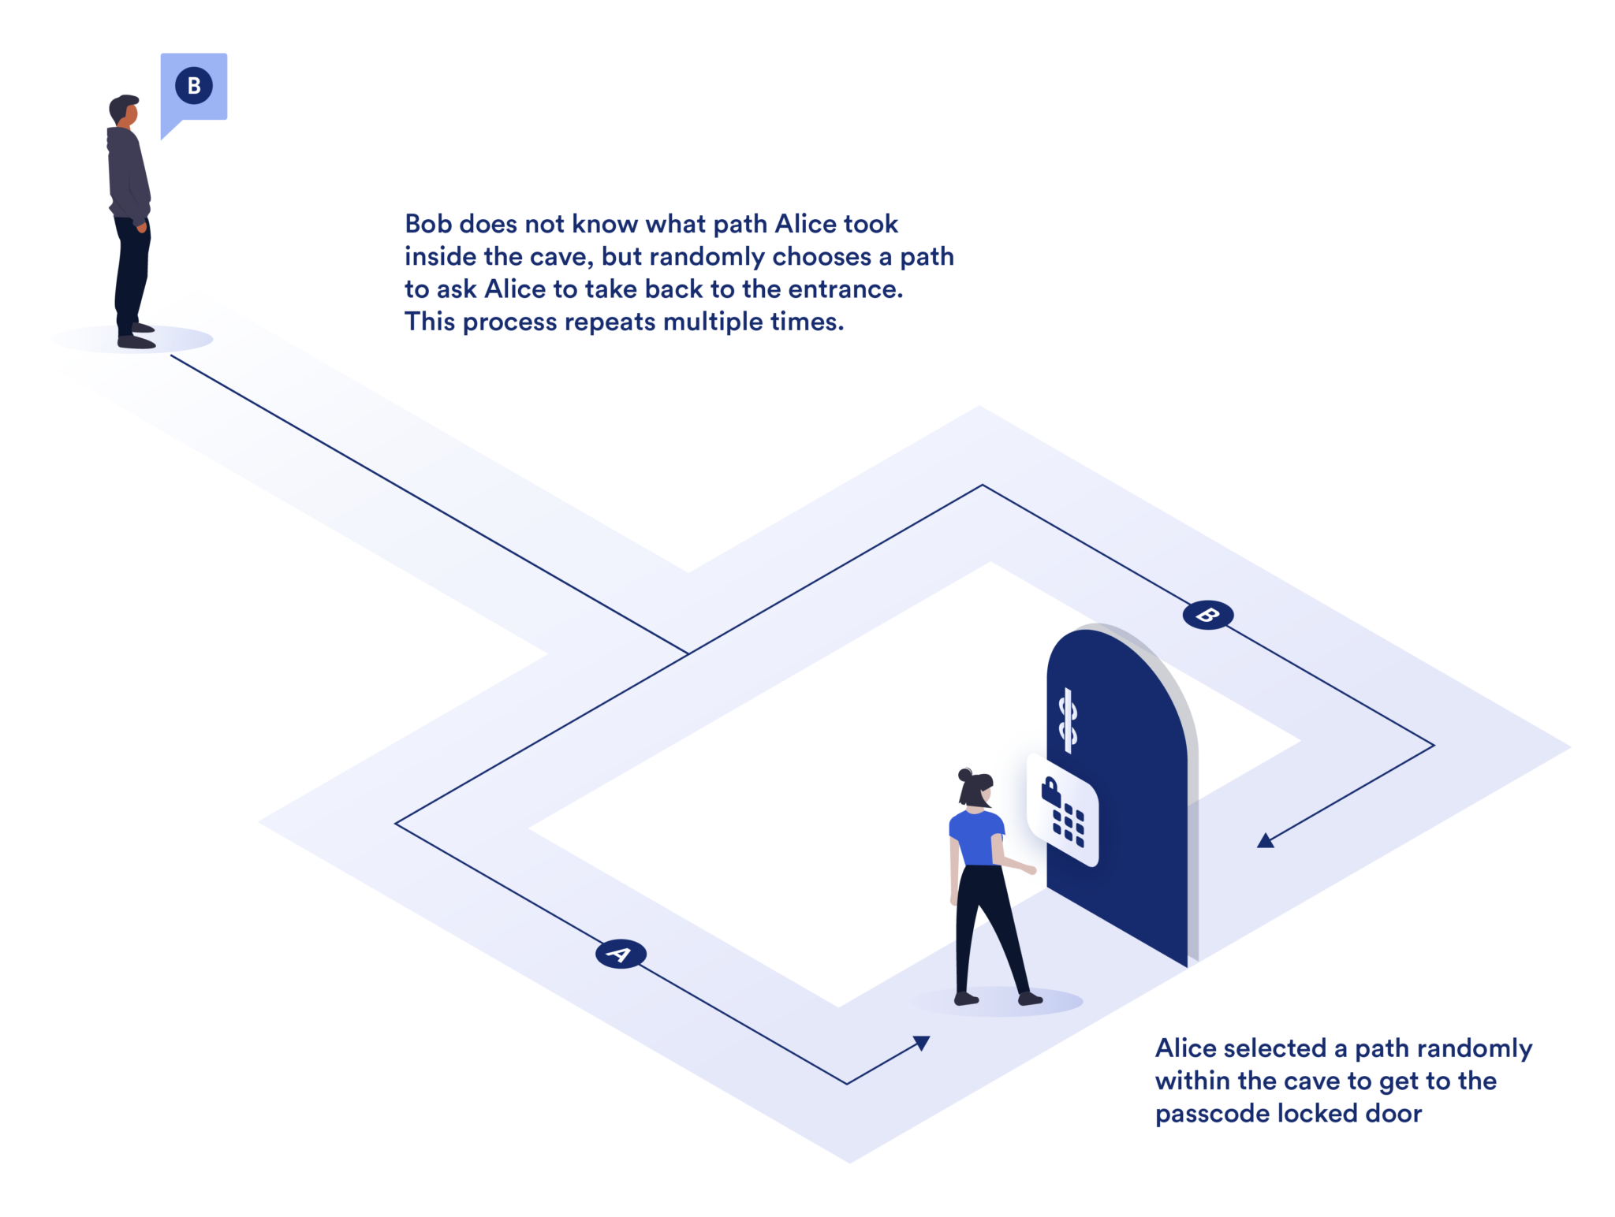
Section 3.1 - Σ-protocols and the Fiat-Shamir Heuristic
Interactive Proof of Knowledge
Zero-knowledge

Slide 3


Section 3.3 - Key Generation
SQIsign.KeyGen Algorithm
Then a secret ideal is computed: I_{secret} = 𝑂₀ (γ(𝑎 + 𝑖)) + 𝑂₀(𝐷_{secret})
Connecting quaternion is found and used to find a connecting ideal

Slide 4
Section 3.3 - Key Generation
B_{0, T} is a basis for E₀[T], the T-torsion subgroup of E₀.
φ_{secret} maps B_{0, T} to the basis for T-Torsion subgroup of E_{A}.

Slide 5


Section 3.3 - Key Generation
P and Q are basis points.
The secret isogeny is applied to Q.
The signing key (the knowledge) is the connecting quaternion, basis of T-torsion subgroup of E_{A}, and mapped basis point Q

